Slide 1
Lars O., title etc
This project has received funding from the European Union’s Horizon 2020 research and innovation programme under grant agreement No 676876.

Slide 2
General info
Start date:1st March 2016
Duration: 48 months
Budget: 7.9 million Euro (with a 6.7 Million Euro grant from the European Union)
Project officer: Silvia Gemini, Research Executive Agency (REA)
Coordinator: Dr. Bruno Fady, INRA, France bruno.fady@inra.fr

Slide 3
Overall concept and expected impact
Provide the European forestry sector with better knowledge and new tools for efficient management and sustainable use of FGR in the context of environmental change and evolving societal demands.
expand the current scientific knowledge on how genetic diversity, phenotypic trait diversity and environmental diversity co-vary over multiple spatial scales,
inform on the genetic basis of phenotypic trait variability and plasticity,
characterise in-situ and ex-situ conservation units and underused natural resources, and
produce models of future species distribution usable for FGR management under diverse policy and environmental scenarios.

Slide 4
Partners
Institut national de la recherche agronomique (INRA), France Agencia Estatal Consejo Superior de Investigaciones Científicas (CSIC), Spain Uppsala Universitet (UU), Sweden Aristotle University of Thessaloniki (AUTH), Greece European Forest Institute (EFI), Finland Bioversity International, Italy Philipps-Universität Marburg (PUM), Germany Consiglio Nazionale delle Ricerche (CNR), Italy Instituto Nacional de Investigación y Tecnología Agraria y Alimentaria (INIA), Spain University of Oulu (UOULU), Finland IGA Technology Services (IGATS), Italy
Norwegian Institute for Bioeconomy Research (NIBIO), Norway Forestry Research Institute of Sweden (Skogforsk), Sweden Johann Heinrich von Thünen Institute (THÜNEN), Germany Bavarian Office for Forest Seeding and Planting (ASP), Germany The Natural Environment Research Council (NERC), Great Britain Aleksandras Stulginskis University (ASU), Lithuania INRA Transfert (IT), France Swiss Federal Institute for Forest, Snow and Landscape Research (WSL), Switzerland Russian Academy of Sciences (RAS), Russia Radiata Pine Breeding Co Ltd (RPBC), New Zealand LIECO Gmbh & Co KGH (LIECO), Austria

Slide 5
Investigated species
Tree species | Distribution | Major threats to FGR | Ex-situ collections in Europe | Nb in-situ DCUs
Abies alba | Alp, Con | Climate change, habitat loss | AT, DE, FR, GR | 318
Betula pendula | Atl, Bor, Con | Habitat loss, grazing | FI, GB, LT, NO, SE | 50
Fagus sylvatica | Atl, Alp, Con, Med | Climate change | DE, ES, FR, IT, GB, SE | 469
Picea abies | Alp, Bor, Con | Climate change, pests | AT, DE, FI, FR, IT, LT, NO, SE | 471
Pinus cembra | Alp | Fragmentation, habitat loss | AT | 56
Pinus halepensis | Med | Forest fire | ES, FR, IT, GR | 26
Pinus nigra | Alp, Con, Med | Habitat loss, hybridization | DE, ES, FR, GR | 145
Pinus pinaster | Atl, Med | Forest fire, pests | ES, FR, IT, GR | 42
Pinus sylvestris | Alp, Bor, Con, Med | Climate change | DE, ES, FI, FR, LT, NO, SE | 313
Populus nigra | Atl, Alp, Con, Med | Habitat loss, hybridization | DE, ES, FR, IT | 30
Quercus petraea | Atl, Con | Pests, hybridization | AT, DE, FR, NO | 250
Taxus baccata | Alp, Atl, Con, Med | Fragmentation, habitat loss | ES, IT | 56

Slide 6
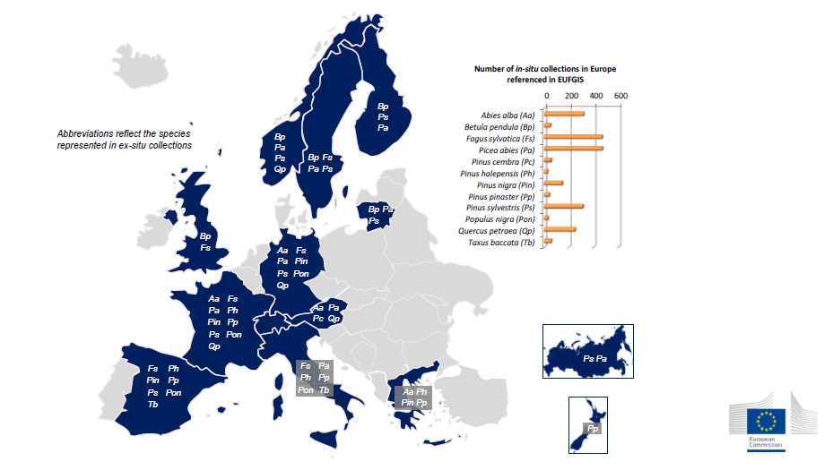
In-situ and ex-situ collections

Slide 7
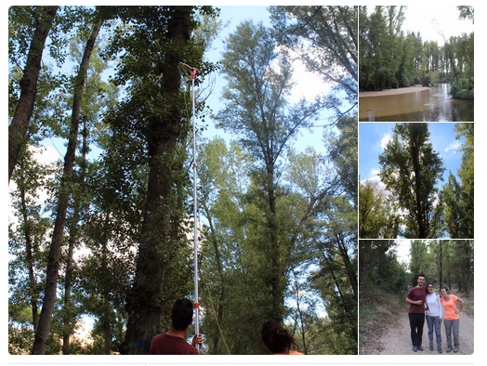
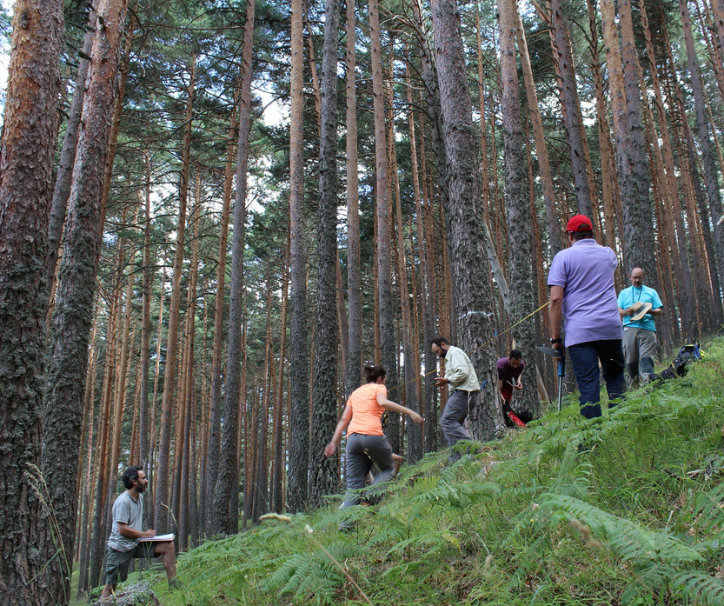
Sampling of trees
Photo: Populus nigra in Rio Alberche (Spain). Credit: Barbara Carvalho/CSIC
Notes:
A total of 12 species are sampled in the project. For each species, trees are sampled in 10 sites. In each site a pair of populations is selected for sampling, within the same type of landscape. The two populations in a pair consist of 25 trees each, and are located at two opposite ends of a the specific ecological gradient which is being investigated. Countries where the sampling is ongoing are: Austria, Finland, France, Germany, Greece, Italy, Lithuania, Norway, Russia, Spain, Sweden, Switzerland, United Kingdom.

Slide 8
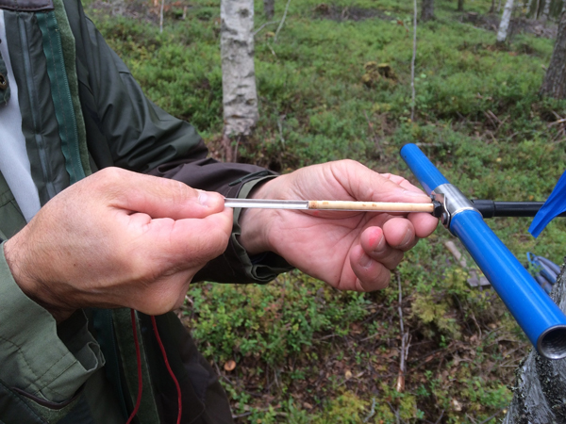
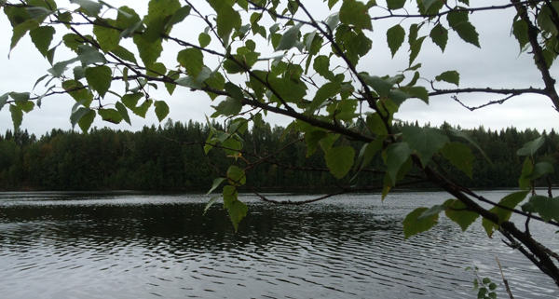
Sampling protocol
Photo: Sampling in Finland. Credit: Tanya Pyhäjärvi
Notes:
The sampling protocol provides step-by-step detailed requirements of traits to measure, data to record about the sites and individual trees, wood and leaf material to sample and describes how to prepare the material for DNA sequencing.

Slide 9
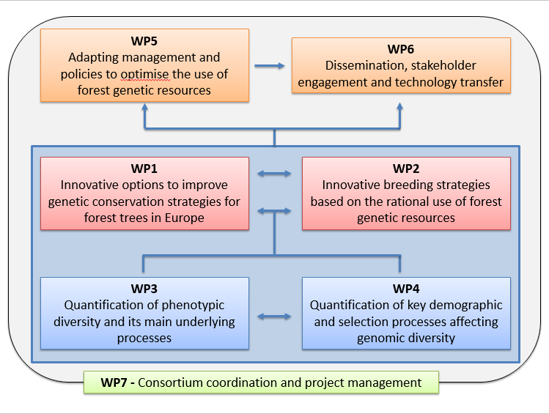
Work packages

Slide 10
EU FGR database for conservation and use
Papers and conferences for the scientific community
Species / FGR distribution models
WP3
Physiologically relevant phenotypes
Current and potential strengths and weaknesses in the EU FGR conservation network
Website and online resources
GenTree nested experimental sampling strategy
European wide network of permanent plots
Knowledge, models and tools on local adaptation
WP6
WP1
Tools for sustainable FGR breeding and conservation
Workshops for stakeholders
WP4
Next Generation genotypes
Simple phenotyping and genotyping in collections and in-situ
WP2
GenTree stakeholder platform
Training courses
New gene and phenotype sampling strategies for conservation and breeding
WP5
FGR-friendly policy options
Good Practices material
Models for FGR-friendly sylviculture
Economic effects of FGR-friendly regulations
FGR monitoring scheme
Notes:
Links between work packages

Slide 11
More information
http://www.gentree-h2020.eu/
@GentreeProject

